Slide 1
Library Management System

Slide 2
Mini Project-2
Library Management System
Name- Parul Upmanyu , Pooja Jain , Sneha Agrawal , Tanya Sharma
University Name- GLA University, Mathura
Department Name- BTech(CSE)
Date- 12-04-24

Slide 3
Introduction
A library management system is a software tool which is used to manage the operations of a library.
Problem or the motivation behind the project- Making the library more efficient, reducing the amount of work needed to run it, and making it easier for members to use the library’s services.
Overview- Providing better services to users . It makes things easier and faster. Easy to use!

Slide 4
Objectives
Clearly state the objectives of your mini project:
To provide a simple way for library users to find, reserve and manage books online .
It will also keep the accurate record of books , users , admin.
Aim to achieve this project:
To provide users with a convenient online platform to search for books.
To maintain and a precise and up-to-date record of library system.
To reduce the workload of librarian and reduce paper work.

Slide 5
Problem Statement
Problem Addressing:
Many libraries still rely on manual methods for cataloging books , recording transactions. These process are time consuming.
Without a computer system, it’s easy to lose track of where books are, which book are borrowed out and which are available.
Why is it important or relevant?
It saves time , makes things easier for users , it helps to make sure that books and other library resources are used well , without waste.
In short , a library management system makes everything run smoother and improves both the experience of the users and the efficiency of the library.

Slide 6
Literature Review
Summarize in the same domain:
It help libraries run smoothly by keeping track of all the books and who borrows them , handling checkouts and returns, and managing member information. They also make it easier for people to access digital books and resources from anywhere.
Highlighting the gap our project is filling:
Some websites might be hard to use or confusing when you want to personalize your book ,our site wants to make it simple for anyone to customize their books.

Slide 7
Methodology
Explain the approach you took to solve the problem:
Develop an intuitive and easy-to-navigate interface that allows users to input their information in a step-by-step manner.
Ensure that the application is responsive and works well on various devices (desktops, tablets, smartphones) to accommodate user’s preferences for accessing and editing their books.
Algorithms, techniques, tools, languages used:
We had used languages like HTML for the basic structure, CSS to make it look good, and JavaScript to add cool features. Node.js , express and mongodb for the backend.

Slide 8
System Architecture
Present the overall architecture of your system:
The UI interact with the system via web browsers. Requests are sent to Node.js server.
The express app on the server handles these requests, interacts with the MongoDB database for data .
MongoDB stores and manages all the data transactions.
Components and how they interact:
Node.js/Express this combination acts as the server . Express , a framework for node.js, simplifies server-side logic and routing. It handles request from the front-end, interacts with the database , and send responses.
MongoDB: The Databases where all data is stored with a flexible schema. This could be pulling up book information, updating user profiles and keep recording every thing.

Slide 9
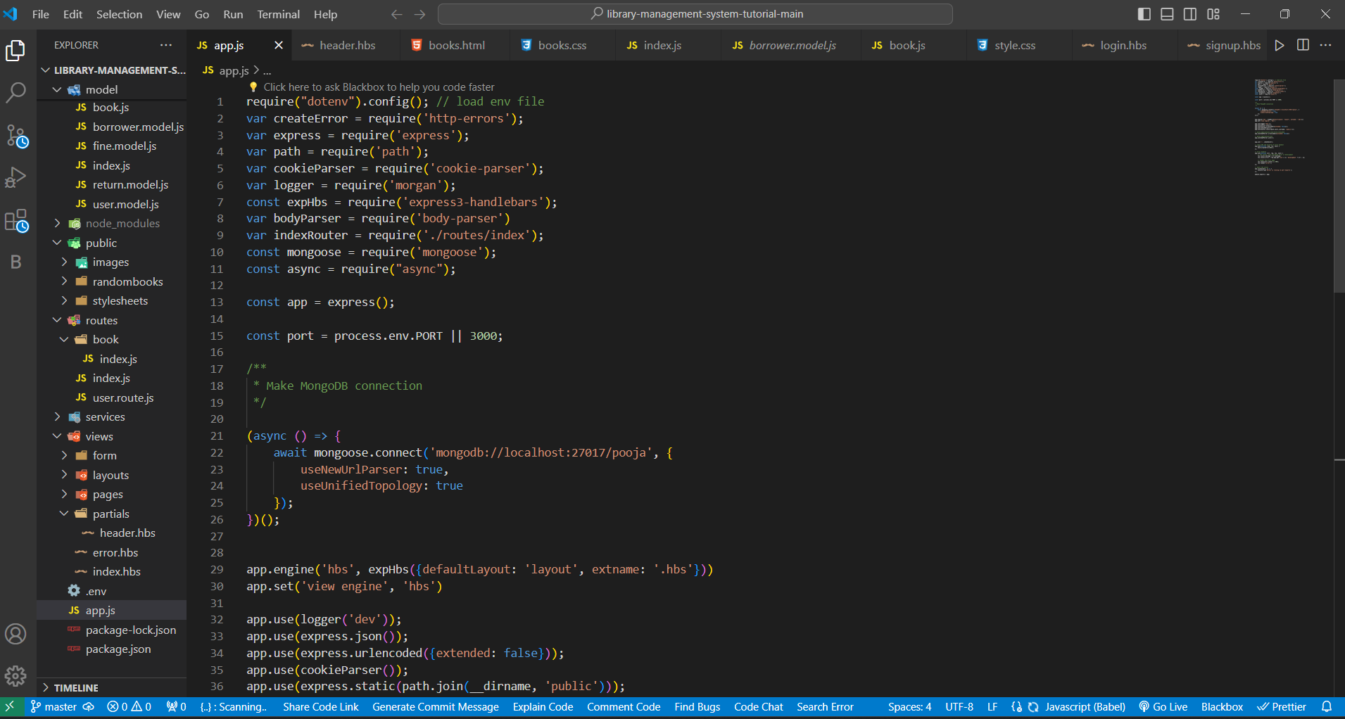
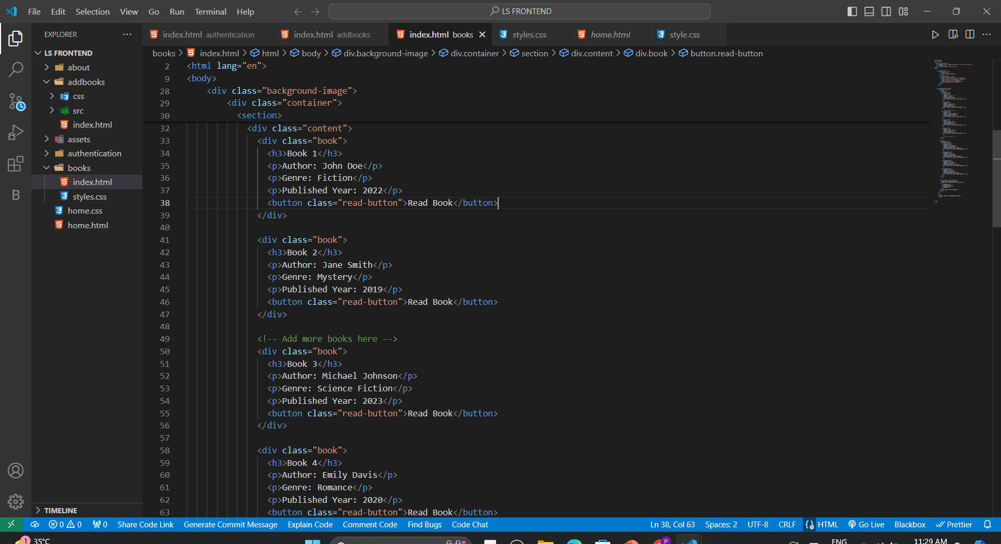
Implementation
Share details about the implementation process

Slide 10
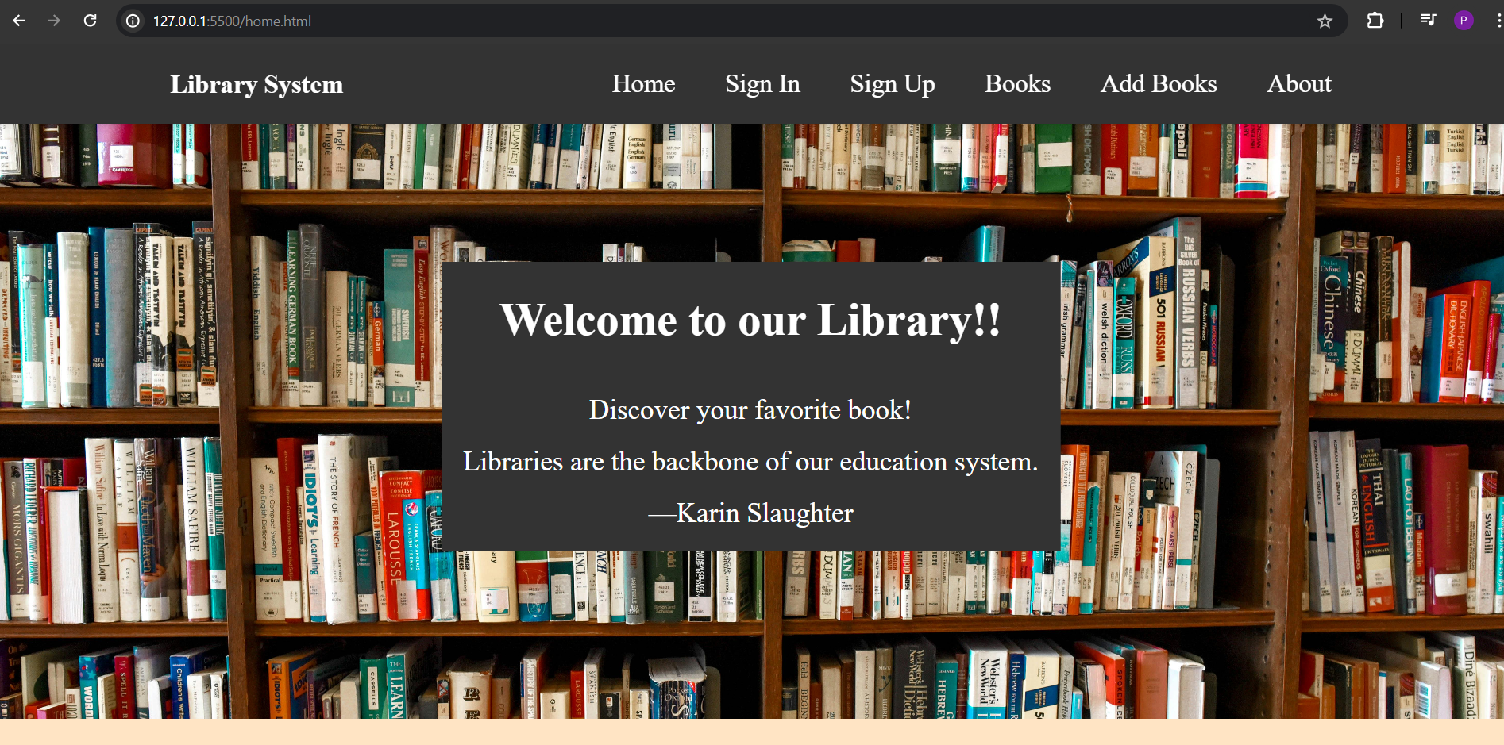
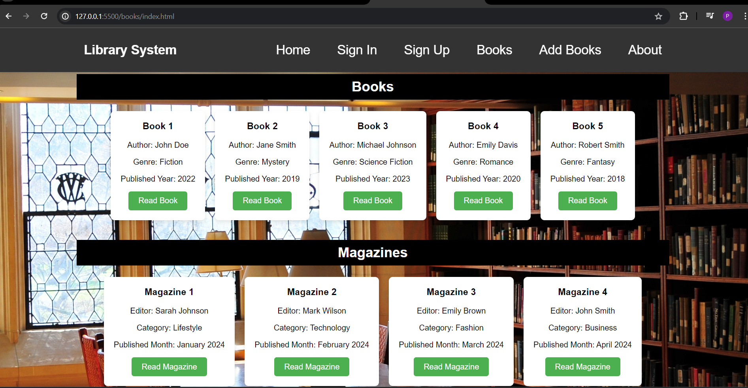
Implementation
Our Project look like this

Slide 11
Features
Highlight the key features of your project:
The library management system features is easy and fast user authentication process, in which user can easily sign in , search for books, and check them out. The system works smoothly on phones, tablets and computers.
Any unique functionalities:
Special features like instant live previews and easy customization. It's super simple, fun.
We have a sign up functionality in three ways (student, admin and teacher).

Slide 12
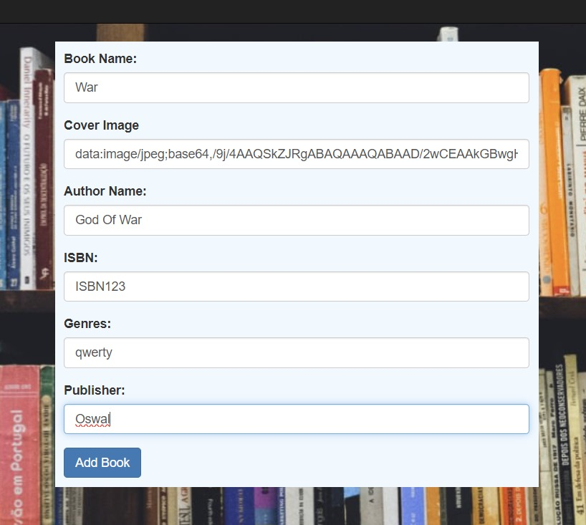

Results
Showcase the results or outcomes of your project

Slide 13
Challenges Faced
Discuss any challenges or obstacles encountered during the project:
Designing a user-friendly interface that accommodates customization while keeping the layout simple can be challenging. Balancing ease of use with flexibility can be a hurdle.
Protecting user’s personal information and ensuring privacy is critical, which means implementing strong security measures.
How you overcame them:
Organize the layout logically, grouping similar elements and creating a seamless flow of information. Use intuitive labeling and visual cues to guide users through the library management process .

Slide 14
Future Work
What could be done to improve or extend the project in the future:
Include more e-books and audiobooks .
Improve the search tool to allow more specific filters, helping users find exactly what they want more easily.
Ensure the system is easy to navigate and read for all users, including those with disabilities.
Any additional features or functionalities:
Send notifications when a reserved book becomes available or when due date is approaching.

Slide 15
Conclusion
Summarize the key points of your presentation:
So , basically we our presenting a online tool in which users can sign up and make a well design book and he/she can purchase that book.
Reiterate the significance of your project:
With this system, people can access the library’s services from anywhere. In simple terms, a library management system makes using the library easier, more accessible and more enjoyable for everyone.
This project helps in understanding the creation of an interaction between the student and the librarian.

Slide 16
Acknowledgement
I just wanted to take a moment to say a massive thank you to our mentor for all your help and support with our [Library Management System] project. Without your contributions, this wouldn't have been possible.

Slide 17
Q&A
1. What features does the system offer for user management?
- It offers features for user management such as creating and managing user profiles, setting different access levels(like student, teacher, or staff).
2. Is there an online reservation feature available for users?
- No, right now we don’t have but we will we working on this in future.

